Slide 1


Slide 2
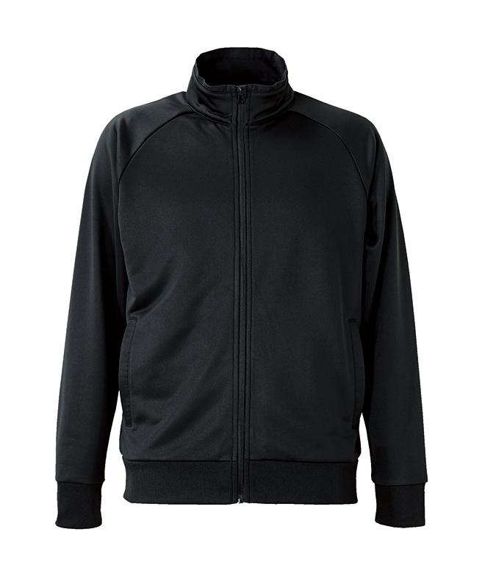
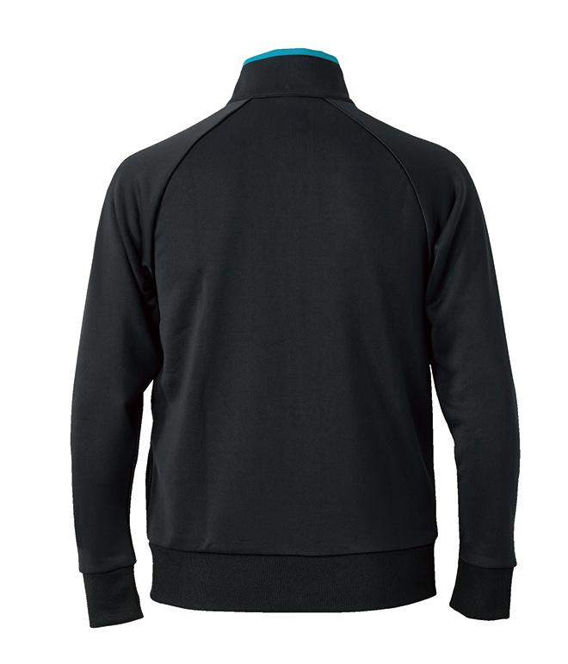



Slide 3
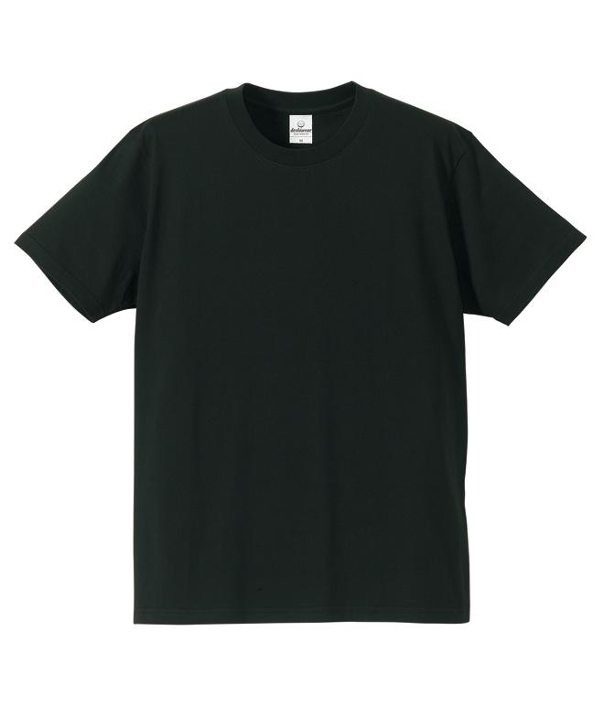
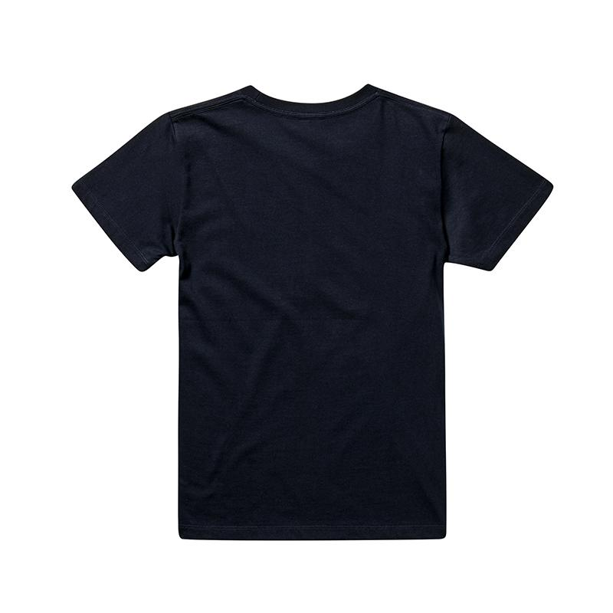

Slide 4
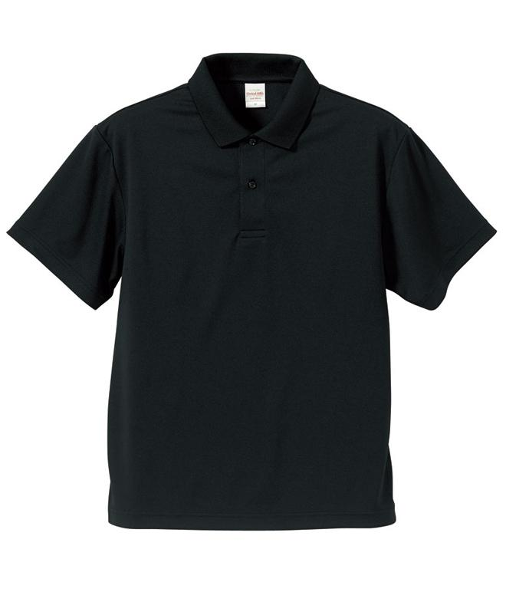
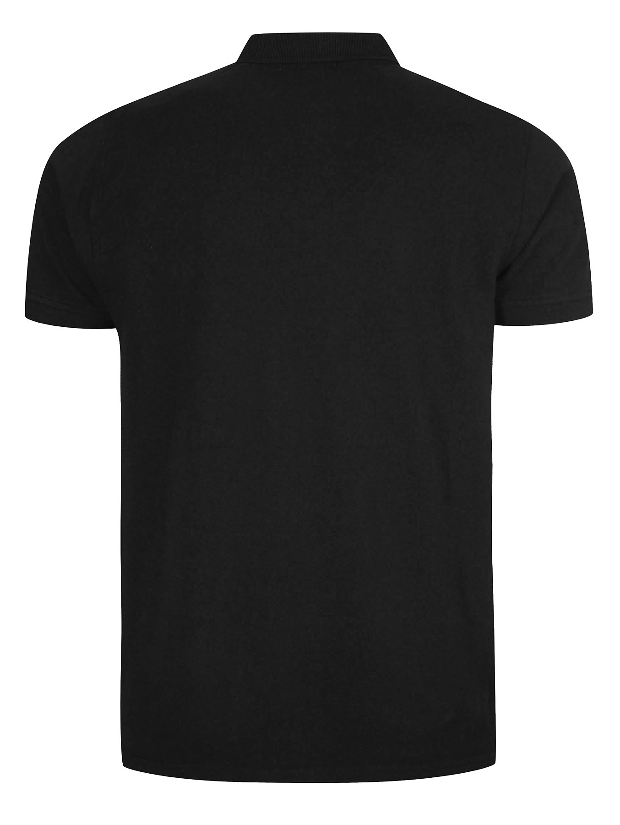

Slide 5
final sketches

Slide 9
test sketches

Slide 11
SHEW
DRIVER
SHINAGAWA

Slide 12
CAJ KNIGHTS ROBOTICS

Slide 13
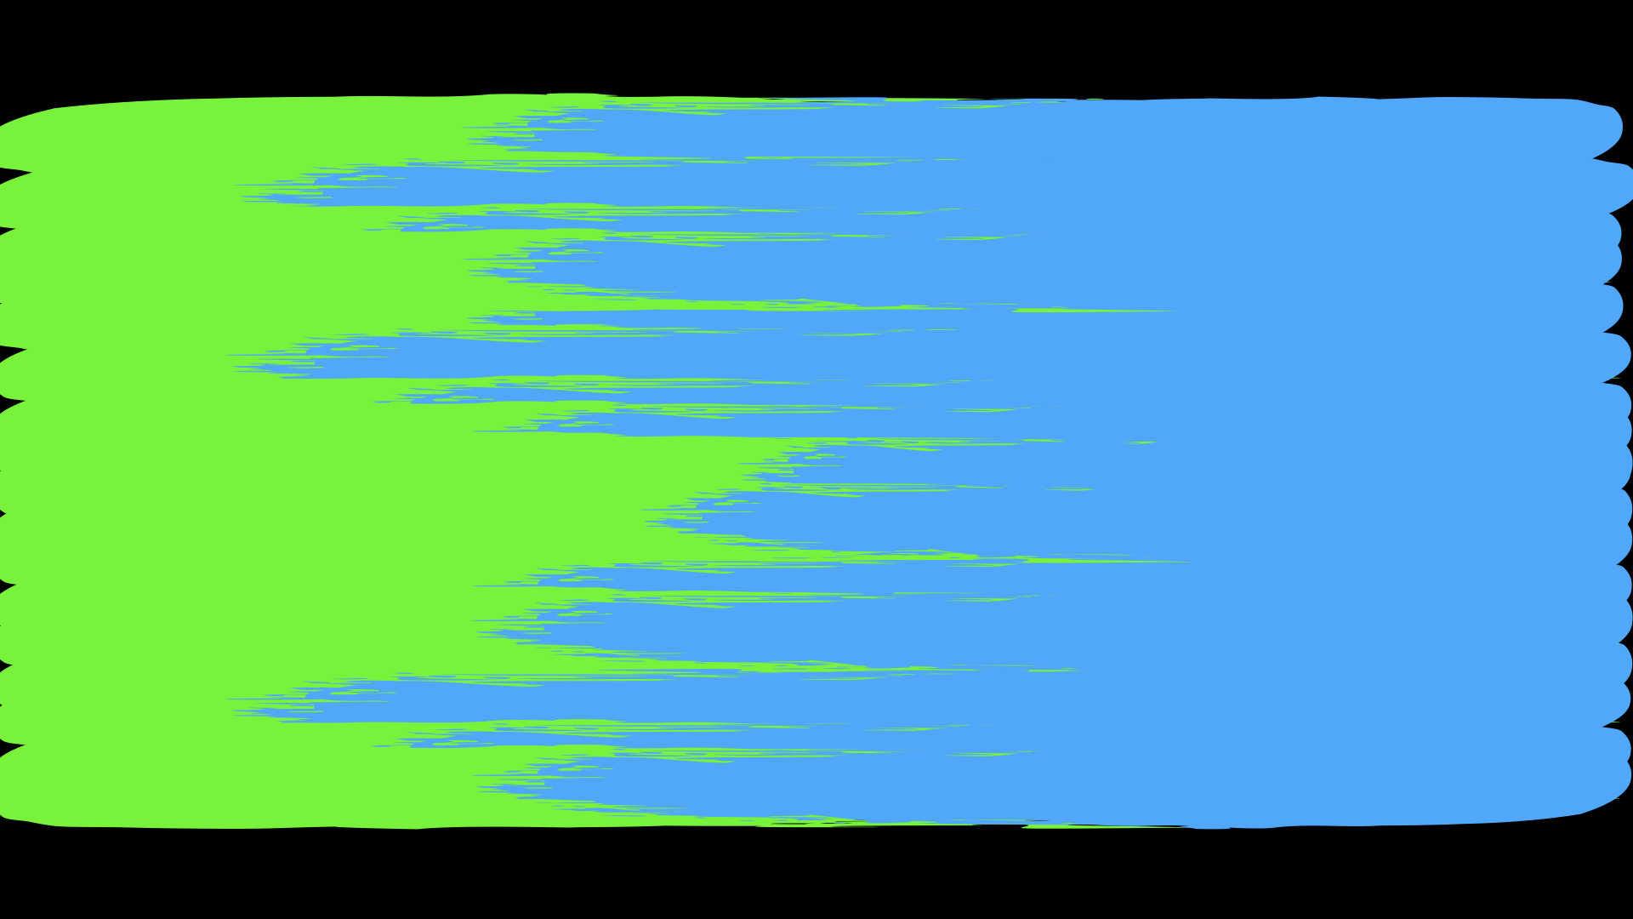


Slide 14


Slide 16


